Slide 1
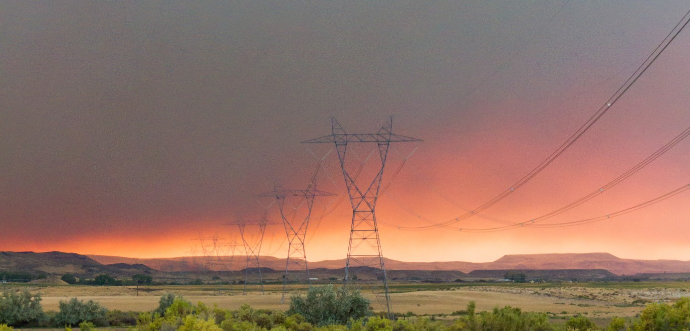
Hero 2 Troubleshooting the SSR Assembly

Slide 2
Unit Won’t Interrupt/Fails the Interruption Test
From the website, select the unit (left click on the unit ID number).
Hover your mouse over the “Command” menu and choose the “Send Command” tab.
From the “Send Command” menu choose the “Check Interrupter” command. Send & confirm.
Go back to the User Main page, hover your mouse over the “View” menu and select the “Raw Data” tab.
When the unit has completed operating the “Check Interrupter” command, there is a line of data that comes back in the “Raw Data” page that looks like this:
:Relay PASS (X->0 mV) | GPS PASS
The unit will indicate Pass/Fail for the Relay and/or GPS. The instructions below are provided if the unit fails the “Relay” portion of the interruption test.
If the unit Fails the GPS portion, a new Cell/GPS antenna is called for or the GPS chip has failed in the Com Module.

Slide 3
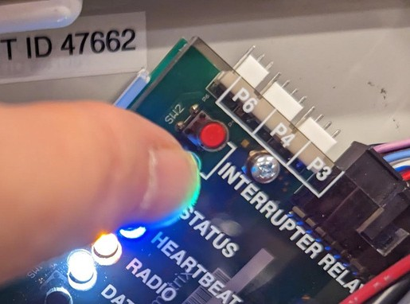
Trouble Shooting the (on board) Pilot Relay & External SSR W/ Bypass:
Make sure:
• The AC power to the Rectifier is ON
• The 6-volt battery is charged & connected to the Hero 2 monitor
• The Green (Status), Orange (Radio) and White (Data) LEDs are all on and the Blue (Heartbeat) LED is flashing once per second
Start an interruption cycle by:
• Pressing and holding the Red Interrupter Relay button on the Interface board for at least ten seconds

Slide 4
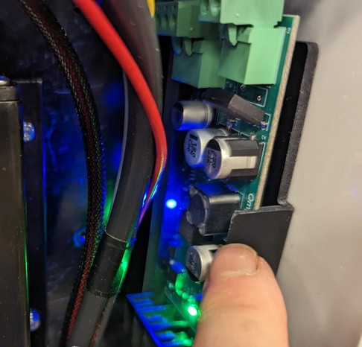
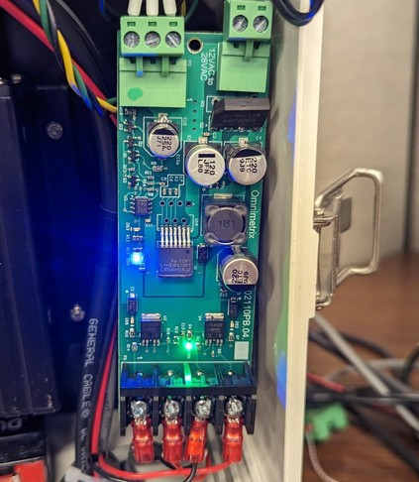
Release the SSR Control from the Enclosure
From Left to right, on the black wiring block (at the bottom of the SSR Control board), the wires should be:
• Grey Jacket - Black wire/Red wire.
• Black Jacket - Black wire/Red wire.

Slide 5
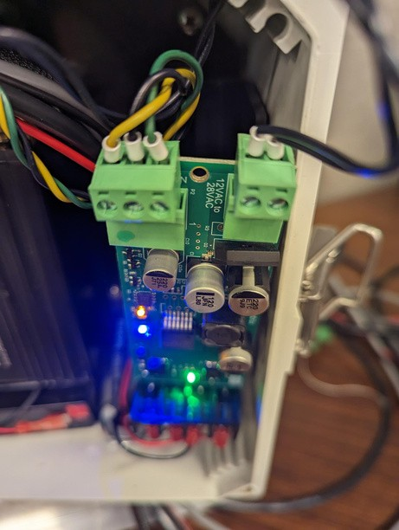
Using your meter set to VAC:
Measure across the black wires on the two-pin phoenix connector located at the top of the SSR Control board
• You should see the same AC reading that you are powering your Hero 2 from.
• Alternatively, (for older SSR assemblies) the same AC voltage that you have at the two black wires attached to on the taps.
• If you don’t see this AC voltage, troubleshoot the black wires.

Slide 6
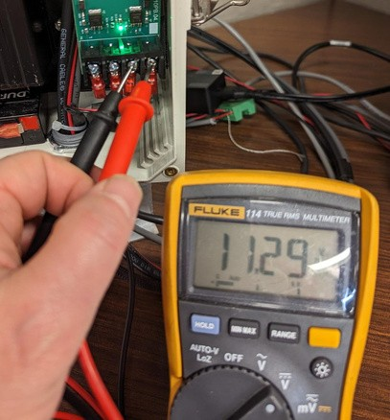
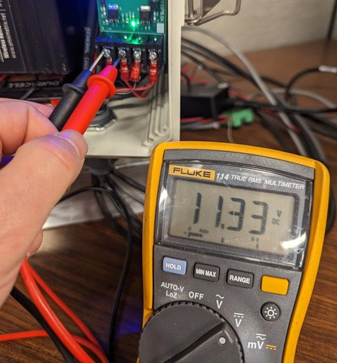
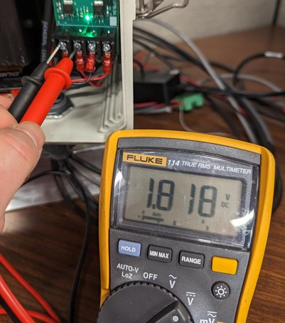
Once the unit starts interrupting
With your meter set on VDC, take a reading across the 2 right pins on the black wiring block on the bottom of the control board.
• You should get a constant ~12 VDC. If you don’t, replace the SSR control board
Take a VDC reading on the left side of the black wiring block:
• The reading should be ~12VDC for the 7 seconds the RED led (on the interface board) is off and >2VDC for the 3 seconds it is on
If you don’t see the shift, the problem is SSR Control Board or inside the Hero 2 RMU and you should proceed to slide 11. If you do see the shift, continue with slide 7

Slide 7
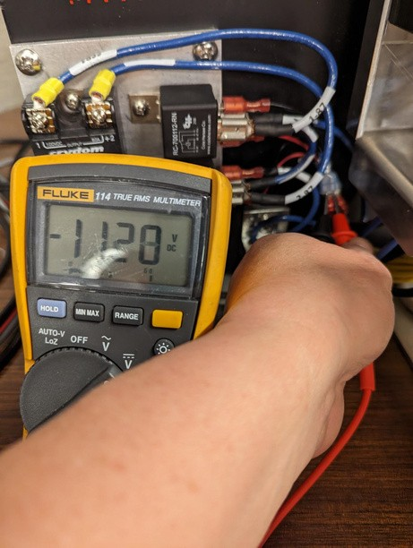
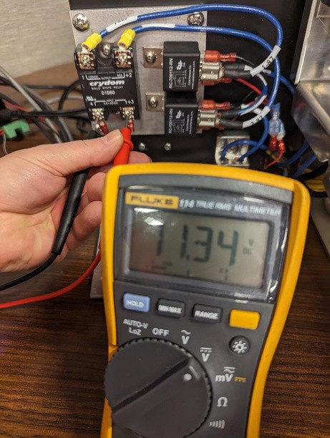
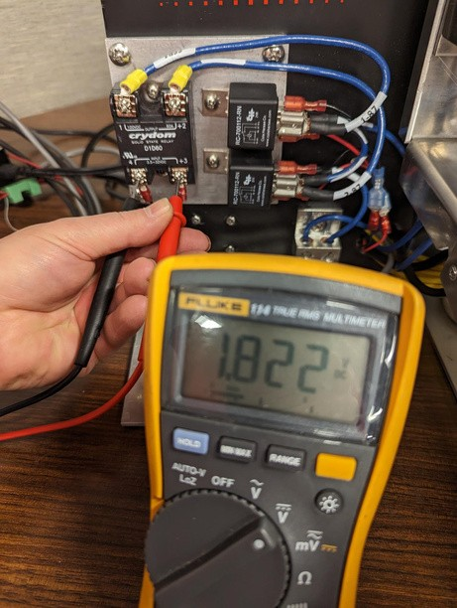
• Measure the VDC at the bypass relay. You should get the same voltage as at the control board. If you don’t, troubleshoot the wiring
• Make sure the RED wire goes to the +3, and BLACK to the 4 on the SSR
• Measure the VDC across pins 3 & 4 on the SSR. If you have the proper reading at the control but not at the SSR, troubleshoot the wiring

Slide 8
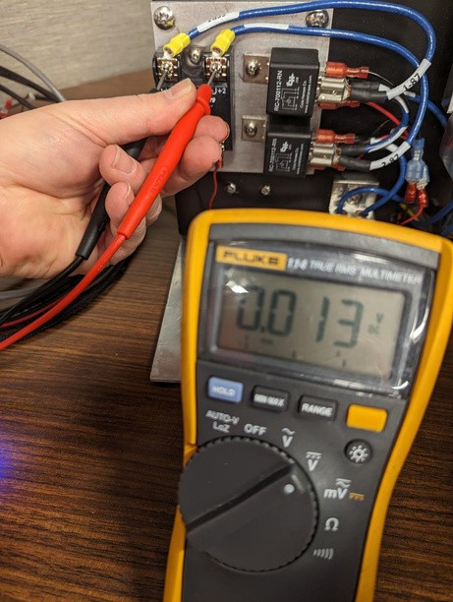
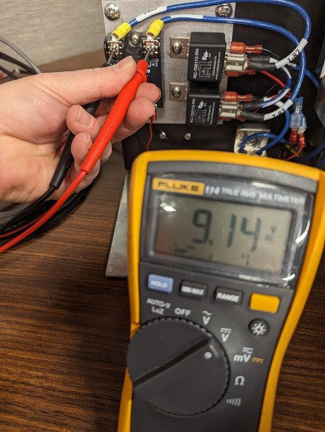
With your meter set to VDC, take a reading across pins 1 & 2 on the SSR
• You should see ~0VDC when the relay is closed and the unloaded Rectifier VDC value when the relay is open
If you don’t see this pattern, the SSR is bad or one (or both) of the bypass relays is non- functional
Leave the battery attached in the unit and turn off the AC breaker to the rectifier
Remove one of the Blue Current protection wires from where it is landed in, or on, the rectifier

Slide 9
• Leave the AC breaker off
• With your meter set to Tone (or Ohms)
• Place your probes on position 1 of the SSR and on the end of the Blue Current Protection wire marked “RECT-”. You should hear no tone (or see OL)
• Place your probes on position 2 of the SSR and on the end of the Blue Current Protection wire marked “PIPE”. You should hear no tone (or see OL)
• If you don’t see these results, with either bypass relay, that bypass relay should be replaced

Slide 10
• Turn the AC breaker back on
• With your meter set to Tone (or Ohms)
• Place your probes on position 1 of the SSR and on the end of the Blue Current Protection wire marked “RECT-”. You should hear constant tone (or see ~0 Ohms)
• Place your probes on position 2 of the SSR and on the end of the Blue Current Protection wire marked “PIPE”. You should hear constant tone (or see ~0 Ohms)
• If you don’t see these results, with either bypass relay, that bypass relay should be replaced
• Place your probes on position 1 and 2 of the SSR. You should hear tone (or see~0 Ohms) for the time the relay is closed (Red LED is OFF on the Interface Board) and no tone (or OL on your meter) when the Red LED is ON.
• If you don’t see these results, the SSR should be replaced

Slide 11
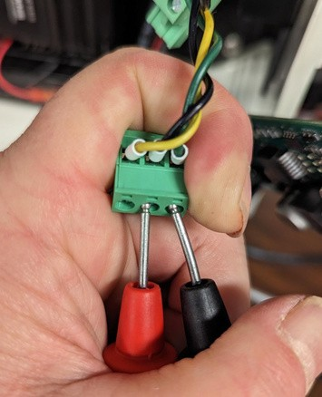
Continued from Slide 6, unit still interrupting…
• Remove the 2-pin phoenix connector from the SSR Control board Remove the 3-pin phoenix connector from the SSR Control board
• Set your meter on Tone (or Ohms) and place your probes on the screwheads of the center (black wire) and right (green wire) positions of the 3-pin phoenix connector
• You should hear tone when the Red Interrupter LED is off meaning the interrupter relay is closed (or ~0 Ohms) and no tone when the interrupter is open (or OL on your meter)
• If you see this pattern, the SSR Control board is bad and should be replaced. If you don’t, go to slide 11

Slide 12
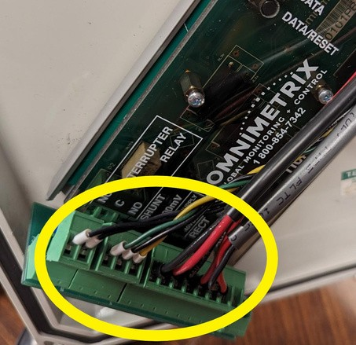
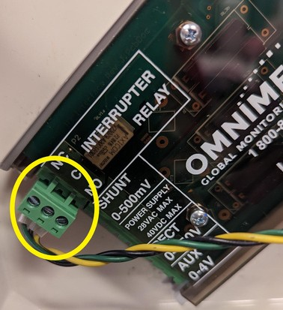
If the unit is not shifting:
Take the Surge Suppression Module out of the Interface board and put the 3-pin phoenix connector directly into the 3-pin receiver on the Interface board
Repeat the previous tests done on the 3-pin phoenix connector
If you do not see the shifting pattern, the Pilot Relay on the Interface board is bad and this board should be replaced.
If you do see the shifting pattern, the Surge Suppression Module should be changed.
After replacing what needs to be replaced, check that the shift is occurring across the bottom left-hand pins of the SSR Control board.

Slide 13
• If you get good results from all of the tests previously listed, the interruption problem lies within the rectifier itself.
• I would carefully check wiring to see if any of the monitor wires were pinched.
• Pay particular attention to the area around where the 3ʳᵈ stud was drilled into the phenolic surface, to accommodate the interruption circuit. It is very easy to pinch one of the small wires underneath this stud, which will interfere with your interruption cycle.

Slide 14
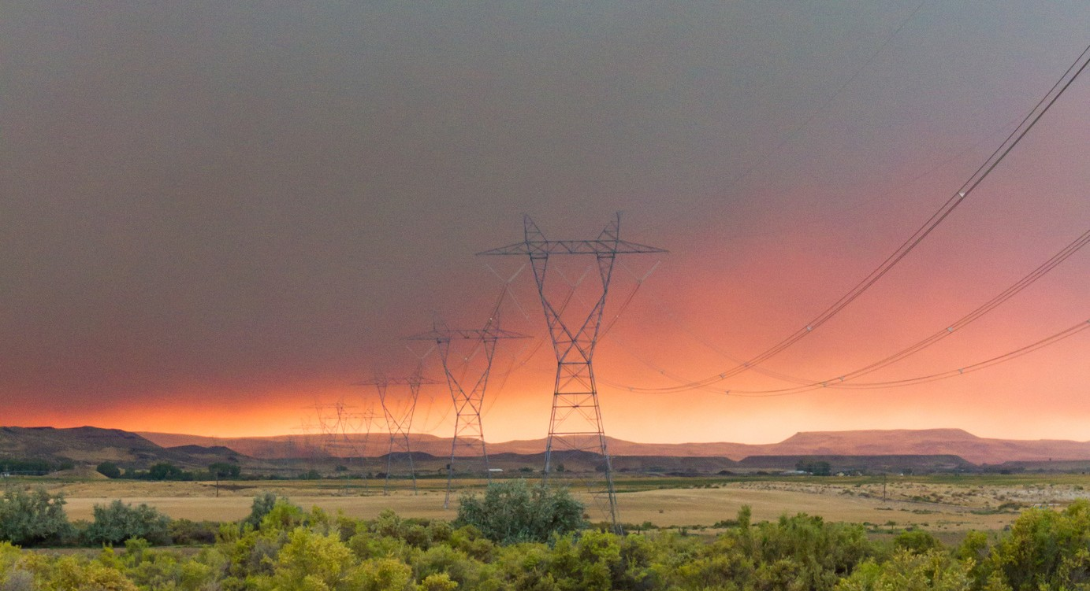
THANK YOU

